Slide 1


Manulife
AZURE KUBERNETES SERVICES
IN ALM

Slide 2

CONTENT
Manulife
01
WHAT IS KUBERNETES?
02
WHERE AND HOW WE ARE USING IT?
03
TROUBLESHOOTING
04
AZURE KEY VAULT
05
SETTING-UP SSO
06
AZURE APP REGISTRATIONS AND ENTERPRISE APPLICATIONS
07
Q&A?

Slide 3
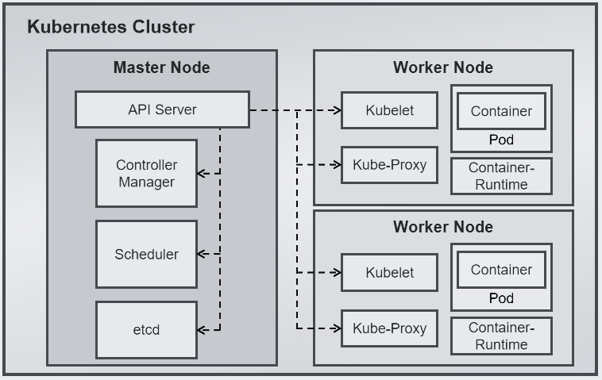
KUBERNETES
Manulife
Kubernetes is a container orchestration tool. Kubernetes automates tasks like deploying applications, scaling, monitoring, and rolling out changes. It also helps with service discovery, load balancing, and resource allocation.
KEYWORDS
Cluster
Nodes
Pod
Container
deployments
events

Slide 4
KUBERNETES
Manulife
It has below basic components.
Cluster
KEYWORDS
Node 1
Node 2
Node 3
Node 4
Cluster
Nodes
Pods
Containers
Node 5
Pod 1
Pod 2
Pod 3
Container 1
Container 3
Container 2

Slide 5

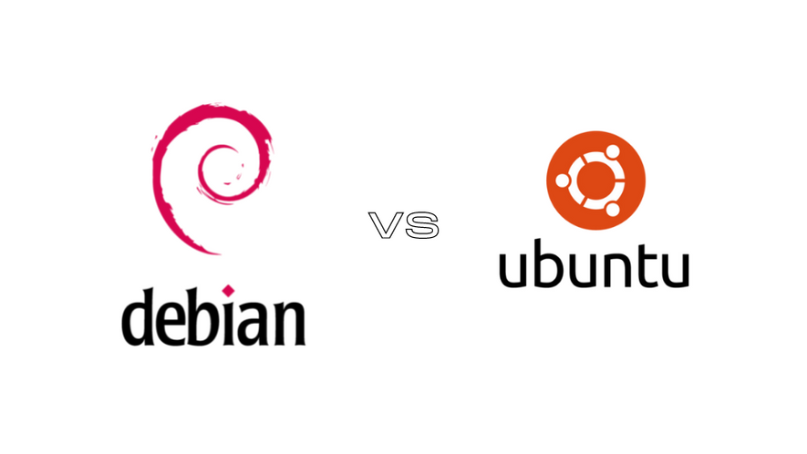



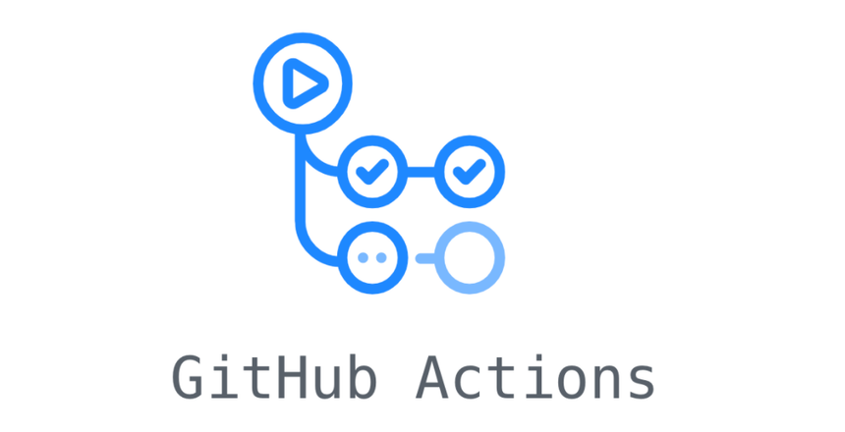


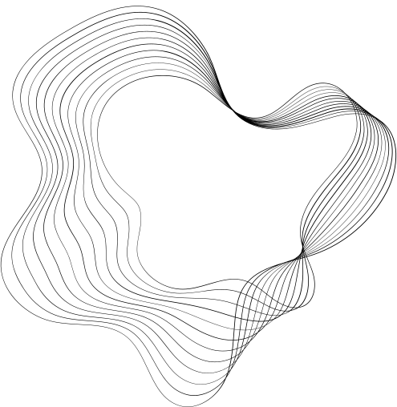
ALM
Manulife
AZURE KEY VAULT

Slide 6

TROUBLESHOOTING
Cheking pod logs for better understanding, what went wrong in deployment
Subscription name
Namespare
Resource group
Pod name
App name
Deployement name
kubectl
azure cli
command prompt
az login --user <username> --password <pwd>
az account set --subscription <subscription_name>
az aks get-credentials --resource-group <rg_name> --name <app_name>
kubectl get pods -n <namespace>
kubectl logs <pod_name> -n <namespace>

Slide 7
STEPS TO MOVE TO AKS
app registration (rasie snow request
collect required information including secrets
create a docker image
create pipeline and required info like SPNs for ACR and AKS
setup akv and mapping with help of AKS team
whitelisting everything for inter-network transitions
setup environment in github

Slide 8
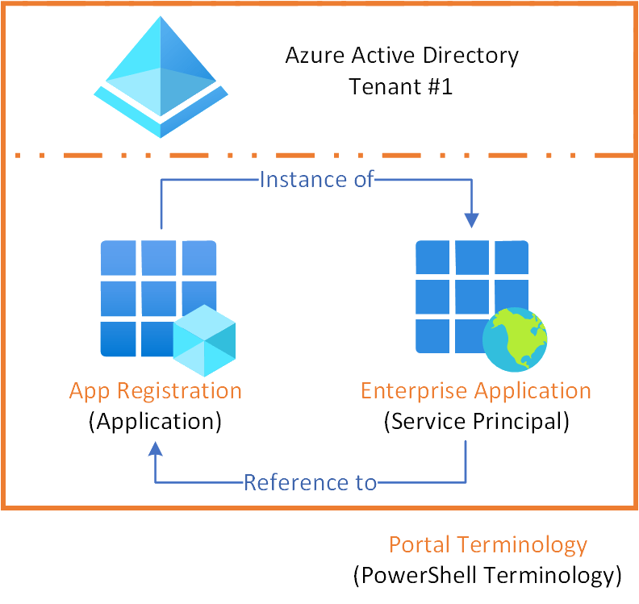
APP REGISTRATION
Manulife
KEYWORDS
Directory (Tenant ID)
Application (Client ID)
Client Secret ID
Client Secret Value

Slide 9

AZURE KEY VAULT
Manulife
KEYWORDS
Subscription ID
Key vault URI
Object
Key name
Key Secret

Slide 10
STEPS TO MOVE TO AKS
app registration (rasie snow request
collect required information including secrets
create a docker image
create pipeline and required info like SPNs for ACR and AKS
setup akv and mapping with help of AKS team
whitelisting everything for inter-network transitions
setup environment in github

Slide 11

Manulife
THANK YOU
Q&A

